Slide 1
Digital Electronics
Trainer: Sohail Inamdar

Slide 2
Section C
.
Section C
Digital Electronics
(20 Questions)
Microprocessor
(15 Questions)
Computer Organization
(15 Questions)

Slide 3
Digital Electronics
Signals
Types
Number System
Types
Conversions
Boolean Algebra
Operators
Laws of Boolean Algebra
Simplification of expressions
Minterm/Maxterm
SOP/POS
SOP/POS conversions
Logic Gates
Combinational Circuits
Arithmetic and Logical circuits
Data transmitters
Code Convertors
Sequential Circuits
Flip Flops
Shift Registers
Counters

Slide 4
Signals
A signal is an electromagnetic or electrical current that is used for carrying data from one system to another. Signals are of two types.
Analog signals
Digital signals
Analog signal is a continuous signal in which one time-varying quantity represents another time-based variable.
A digital signal is a signal that is used to represent data as a sequence of separate values at any point in time.

Slide 5
Number System
Decimal number system
Has 10 symbols or digits hence base = 10
Max value of digit = 9 (1 less than base)
Symbols – 0,1,2,3,4,5,6,7,8,9
Each position represents a specific power of base 10
Hexadecimal number system
Has 16 symbols hence base = 16
Max value of digit = 15
Symbols – 0,1,2,3,4,5,6,7,8,9,A,B,C,D,E,F
Each position represents a specific power of base 16
Octal number system
Has 8 symbols hence base = 8
Max value of digit = 7
Symbols – 0,1,2,3,4,5,6,7
Each position represents a specific power of base 8
Binary number system
Has 2 symbols hence base = 2
Max value of digit = 1
Symbols – 0,1
Each position represents a specific power of base 2
In binary number system each digit or symbol is called as bit

Slide 6
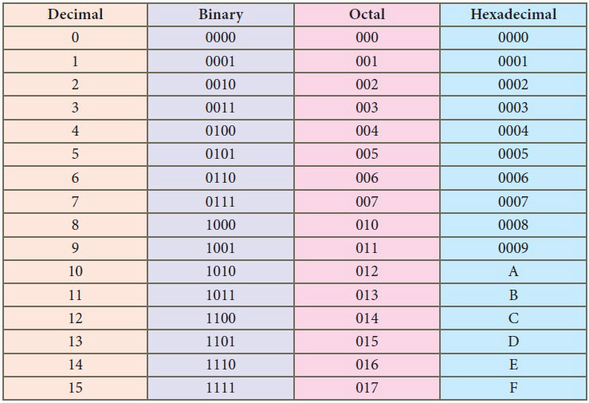
Number System

Slide 7
Number System Conversions
Conversion – Other base to Decimal
Step 1 – Determine the column (position) value of each digit (depends on position of digit and base of number system)
Step 2 – Multiply the obtained column value by the digits in the corresponding column
Step 3 – Sum the products calculated in step 2.
The total is the equivalent value in decimal.
Octal to Decimal
(2057)₈ = ( ? )₁₀
(4706)₈ = ( ? )₁₀
(3619) ₈= (? ) ₁₀
Hexadecimal to Decimal
(1AF)₁₆ = ( ? )₁₀ (2E3)₁₆ = ( ? )₁₀
(124)₁₆ = ( ? )₁₀ (B2C)₁₆ = ( ? )₁₀
Binary to Decimal
(10101)₂ = ( ? )₁₀
(11101)₂ = ( ? )₁₀
(10110)₂ = ( ? )₁₀

Slide 8
Number System Conversions
Conversion – Decimal to Other Base
Step 1 – Divide Decimal Number by new base
Step 2 – Get remainder from step 1 as right most digit (Least significant Digit) of new base
Step 3 – Divide quotient of previous division by new base number
Step 4 – Record the remainder from step 3 as next digit of new base number
Repeat step 3 and 4, until quotient becomes zero
Decimal to Octal
(952)₁₀ = ( ? )₈ (681)₁₀ = ( ? )₈
(373)₁₀ = ( ? )₈ (1246)₁₀ = ( ? )₈
Decimal to Hexadecimal
(254)₁₀ = ( ? )₁₆ (934)₁₀ = ( ? )₁₆
(1952)₁₀ = ( ? )₁₆ (2481)₁₀ = ( ? )₁₆
Decimal to binary
(13)₁₀ = ( ? )₂
(189)₁₀ = ( ? )₂
(216)₁₀ = ( ? )₂
(89)₁₀ = ( ? )₂
(127)₁₀ = ( ? )₂

Slide 9
Number System Conversions
Conversions – Other base to other base
Step 1 – Convert other base to decimal
Step 2 – Convert decimal to new base number
(545)₆ = ( ? )₁₀ = ( ? )₄
(659) = ( ? )₁₀ = ( ? )₄
Conversions – Shortcut methods for converting binary, hexadecimal and octal
(001 101 010)₂ = ( ? )₈ (562)₈ = ( ? )₂
(0011 1101)₂ = ( ? )₁₆ (2AB)₁₆ = ( ? )₂
Conversions – Fractional numbers
(110.101)₂ = ( ? )₁₀ (127.54)₈ = ( ? )₁₀ (4.47)₁₀ = ( ? )₂

Slide 10
Binary Addition
0 + 0 = 0
0 + 1 = 1
1 + 0 = 1
1 + 1 = 0 with Carry 1
Binary Addition
0 - 0 = 0
0 - 1 = 1 with borrow
1 - 0 = 1
1 - 1 = 0
Binary Multiplication
0 x 0 = 0
0 x 1 = 0
1 x 0 = 0
1 x 1 = 1
Binary Division
101010 / 110

Slide 11
1’s and 2’s Complement
1’s Complement
The 1's complement of a number is found by changing all 1's to 0's and all 0's to 1's. This is called as1's complement.
1 → 0 101011100
0 → 1
010100011
2’s Complement
The 2's complement of binary number is obtained by adding 1 to the Least Significant Bit (LSB) of 1's complement of the number.
2's complement = 1's complement + 1

Slide 12
WEIGHTED AND NON-WEIGHTED CODES
Weighted codes
Weighted binary codes are those binary codes which obey the positional weight principle. Each position of the number represents a specific weight.
Examples of weighted code is BCD. In these codes each decimal digit is represented by a group of four bits.
Non-Weighted codes
In this type of binary codes, the positional weights are not assigned. The examples of non-weighted codes are Excess-3 code and Gray code.

Slide 13
BCD Number
BCD – Binary Coded Decimal.
In this code each decimal digit is represented by a 4-bit binary number.
BCD is a weighted code its weight are 8421.BCD code are used only till 9(0000 to 1001).
BCD to Decimal.
(0101 1000) BCD = ( ? )₁₀ (1001 0110) BCD = ( ? )₁₀
(0110 1000) BCD = ( ? )₁₀ (1000 0010) BCD = ( ? )₁₀
Decimal to Binary
( 6 ) = ( ? )BCD ( 254 ) = ( ? )BCD
( 168 ) = ( ? )BCD ( 85 ) = ( ? )BCD
Binary to BCD and BCD to Binary Conversion.
Step 1- Convert the binary/BCD number to decimal.
Step 2- Convert decimal number to binary/BCD.

Slide 14
Excess-3 code
The Excess-3 code is also called as XS-3 code.
It is non-weighted code used to express decimal numbers.
The Excess-3 code words are derived from the 8421 BCD code words by adding (0011)2 or (3)!" to each code word in 8421.
Decimal to Excess-3
Step 1- Convert decimal to BCD.
Step 2- Add 3 (0101) to this BCD number.
Excess-3 to Decimal
Step 1- Subtract (0011)₂ from each 4 bit of excess-3 digit to obtain the corresponding BCD code.
Step 2- Convert BCD to Decimal.
Binary to Excess-3
Step 1- Convert Binary to decimal.
Step 2- Convert decimal to BCD.
Step 3 - Add 3 (0101) to this BCD number.

Slide 15
Gray Code
It is the non-weighted code and it is not arithmetic codes.
There are no specific weights assigned to the bit position.
It has a very special feature that, only one bit will change each time the decimal number is incremented(only one bit changes at a time).
Gray code is popularly used in the shaft position encoders.
Decimal Number | Gray Code
0 | 0000
1 | 0001
2 | 0011
3 | 0010
4 | 0110
5 | 0111
6 | 0101

Slide 16
Boolean algebra
Algebra that deals with binary number system
George Boole developed it for simplification and manipulation of logic
Boolean algebra uses
+ Binary digits - 0 and 1
+ Logical addition ‘+’ also known as ‘OR’ which follows law of binary addition
+ Logical Multiplication ‘.’ also known as ‘AND’ which follows law of binary multiplication
+ Complementation ‘-’ also known as ‘NOT’ which follows law of binary complement
Boolean algebra is used to simplify Boolean expressions which represent combinational logic circuits.
Operator precedence (scanned from left to right)
()
NOT
AND
OR

Slide 17
Boolean Function
Boolean function is expression formed with
+ Binary variables
+ Operators (AND, OR, NOT)
+ Parentheses and equal to sign
Value of Boolean function can be either 0 or 1
Boolean function can be represented as an algebraic expression or a truth table
e.g. W = f(x,y,z)
Where, W is a function
x,y,z are variables or literals
Minimization of Boolean functions
Minimization deals with
+ Reduction in number of variables
+ Reduction in number of terms
There are 2 methods to minimize any Boolean function
+ Using Boolean laws
+ Using K-map

Slide 18
Laws of Boolean Algebra
Idempotent Law
A * A = A
A + A = A
Associative Law
(A * B) * C = A * (B * C)
(A + B) + C = A + (B + C)
Commutative Law
A * B = B * A
A + B = B + A
Distributive Law
A * (B + C) = A * B + A * C
A + (B * C) = (A + B) * (A + C)
Identity Law
A * 0 = 0 A * 1 = A
A + 1 = 1 A + 0 = A
Complement Law
A * ~A = 0
A + ~A = 1
Involution Law
~(~A) = A
DeMorgan's Law
~(A * B) = ~A + ~B
~(A + B) = ~A * ~B

Slide 19
Standard Form
Minterm
+ Minterm is a product or AND term
+ contains n variables with 2^n possible combinations
+ variables either in normal or in complemented form
e.g. ABC, A’BC, AB’C’
Maxterm
+ Maxterm is a sum or OR term
+ contains n variables with 2^n possible combinations
+ variables either in normal or in complemented form
e.g. A+B+C, A+B’+C
Sum of product (SOP) expression
SOP expression is minterm or minterms logically added(ORed) together.
e.g. A’B + AB
Product of sum (POS) expression
POS expression is maxterm or maxterms logically multiplied(ANDed) together.
e.g, (A+B).(A’+B)

Slide 20
Standard Form
Solve the X(A,B,C) = A + BC convert in Standard SOP form

Slide 21
K-Map
Karnaugh introduced a simplification of Boolean functions in an easy way.
This method is known as Karnaugh map method or K-map method.
It is a pictorial representation of graphical method, which consists of 2# cells for ‘n’ variables. The adjacent cells are differed only in single bit position.
K-map uses Gray code.
2- bits
A B 0 1
0
1
3-bits
A BC 00 01 11 10
0
1

Slide 22
K-Map
Karnaugh Map Simplification Rules-
To minimize the given Boolean function, we draw a K-Map according to the number of variables it contains.
We fill the K-Map with 0’s and 1’s according to its function.Then, we minimize the function in accordance with the following rules.
Rule-1:
We can either group 0’s with 0’s or 1’s with 1’s but we can not group 0’s and 1’s together.
X representing don’t care can be grouped with 0’s as well as 1’s.
Rule-02:
Groups may overlap each other.
Rule-03:
We can only create a group whose number of cells can be represented in the power of 2.
In other words, a group can only contain 2n i.e. 1, 2, 4, 8, 16 and so on number of cells.

Slide 23
K-Map
Rule-4:
Groups can be only either horizontal or vertical.
We can not create groups of diagonal or any other shape.
Rule-5:
Each group should be as large as possible.
Rule-6:
Opposite grouping and corner grouping are allowed.
Rule-7:
There should be as few groups as possible.

Slide 24
K-Map
Simplify the Boolean function F(A,B,C) =Σ(1,5,6,7)
Simplify the Boolean function F(A,B,C) =Σ(0,1,3,4,5)
Simplify the Boolean function F(A,B,C,D) =Σ(0,2,4,6,8,9,10)

Slide 25
Logic Gates
What are logic gates :-
It is physical device which performs logical operation on one or more logical i/p(s) and produces a single logical o/p.
Logical operations :- inversion, logical multiplication, logical sum etc.
Categories:-
Basic Gates : AND, OR, NOT.
Universal Gates : NAND, NOR
Arithmetic Gates : X-OR, X-NOR
Notes:
Basic gates : By using these three gates we can implement any digital ckt.
Universal gates : We called them universal gates bcz by using only NAND gate or only NOR gate we can implement any digital system.

Slide 26
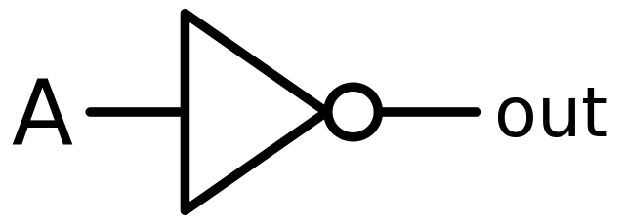
Logic Gates
Truth Table
A truth table show how a logic circuit responds to various combinations of i/p, using logic 1 for true and 0 for false.
Formula for truth table :- 2^{n} = m
Where,
n → number of inputs
M → combination of inputs
NOT Gate :-
.
A | Y
0 | 1
1 | 0

Slide 27
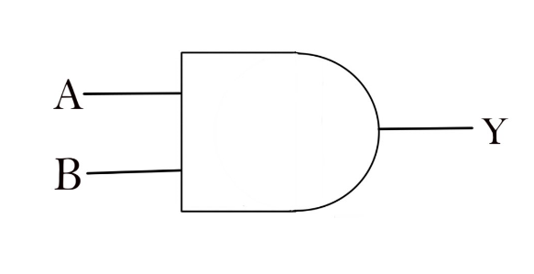
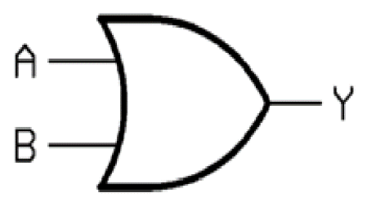


Logic Gates
AND Gate: OR Gate:
NAND Gate: NOR Gate:
A | B | Y
0 | 0
0 | 1
1 | 0
1 | 1
A | B | Y
0 | 0
0 | 1
1 | 0
1 | 1
A | B | Y
0 | 0
0 | 1
1 | 0
1 | 1
A | B | Y
0 | 0
0 | 1
1 | 0
1 | 1
Notes:
Poss i/p combinatios 2²=4
AND Gate :- A&&B Y= A.B (Multiplication)
If any one i/p is 0 then output is zero, If all the i/p are 1 then o/p is 1.
OR gate :- A||B Y=A+B
If any one i/p is 1 then o/p is 1, if all the i/p are 0 then o/p will 0.

Slide 28


Logic Gates
XOR Gate :- XNOR Gate :-
Ques.
XNOR Gate, with 5 i/p.
i.e. 101010 → O/p ?
A | B | Y
0 | 0
0 | 1
1 | 0
1 | 1
A | B | Y
0 | 0
0 | 1
1 | 0
1 | 1
Notes:
XOR Gate :- A B Y= A.Bbar+Abar.B
XNOR Gate :- A.B + AbarBbar

Slide 29
Universal Gate
A Universal gate is a logic gate which can implement any Boolean function without the need to use any other type of logic gate.
NAND gate and NOR gate are universal gate.
Any logic circuit can be built using NAND gate or NOR gate.

